Slide 1

Dimensionality Reduction using Autoencoders
An introduction to deep learning and data analysis using autoencoders for dimensionality reduction. Explore methods for simplifying complex datasets while preserving essential information.
1

Slide 2
What is Dimensionality Reduction?
Definition
Why do we need it?
Examples
Reduces high-dimensional data to lower dimensions.
Faster processing
Images
Easier data visualization
Audio
Noise reduction
Genetic data
Better model performance
2

Slide 3
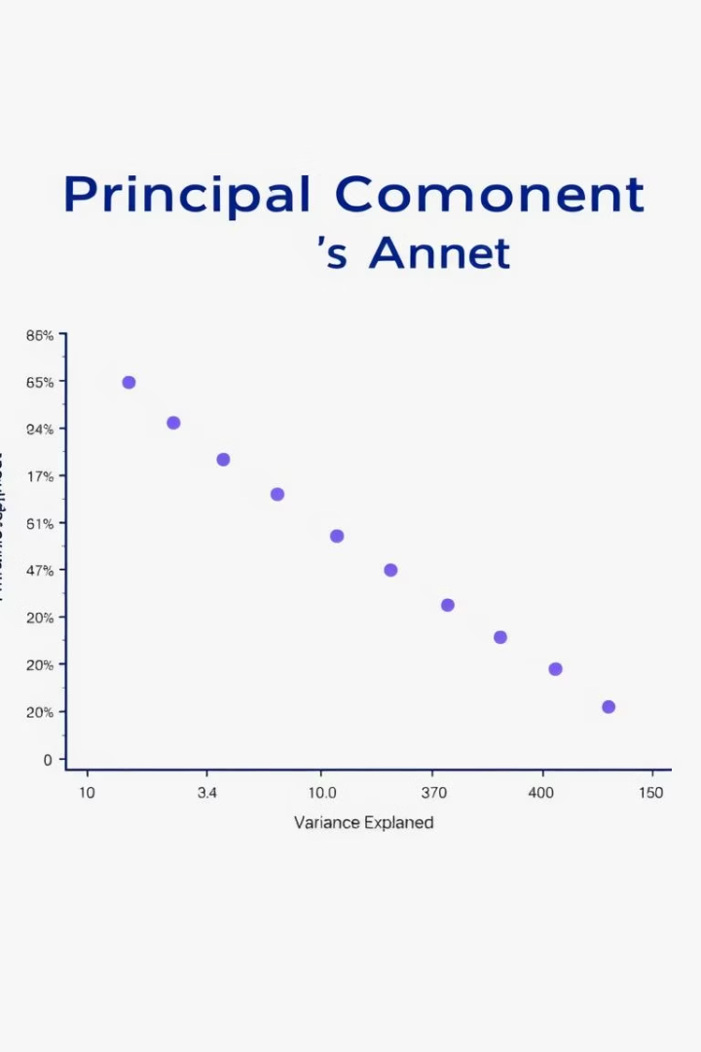
Traditional Methods: PCA
PCA (Principal Component Analysis)
Reduces dimensions
Captures the maximum variance.
Based on linear transformation.
Easy to interpret
Limited with nonlinear data.
3

Slide 4
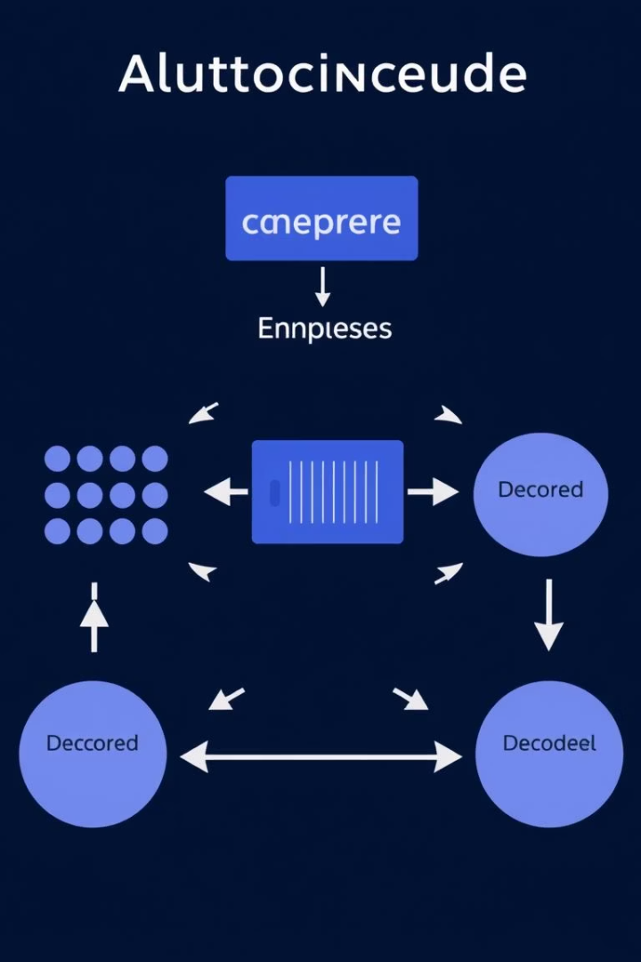
What is an Autoencoder?
Unsupervised neural network
Encoder
Converts input to a lower dimension.
Learns to compress data and reconstruct it.
Decoder
Reconstructs input from the encoded data.
4

Slide 5





How Autoencoders Work
Input
Encoder
Bottleneck
Decoder
Output
Goal: Make the output as close as possible to the original input. The "bottleneck" layer holds the compressed representation.
5

Slide 6

Practical Example: Code
import numpy as np # type: ignore
import pandas as pd # type: ignore
import matplotlib.pyplot as plt # type: ignore
from sklearn.decomposition import PCA # type: ignore
from sklearn.preprocessing import MinMaxScaler # type: ignore
from tensorflow.keras.models import Model # type: ignore
from tensorflow.keras.layers import Input, Dense # type: ignore
from tensorflow.keras.optimizers import Adam # type: ignore
from tensorflow.keras.losses import MeanSquaredError # type: ignore
# 1. Load and preprocess diabetes data
df = pd.read_csv('diabetes.csv')
x_data = df.values
# Scale data to [0, 1] range
scaler = MinMaxScaler()
x_data = scaler.fit_transform(x_data)
# Split into train/test (80/20)
split_idx = int(0.8 * len(x_data))
x_train = x_data[:split_idx]
x_test = x_data[split_idx:]
6

Slide 7
Practical Code
# 2. Atoencoder Model
input_dim = x_train.shape[1]
encoding_dim = 4 # Smaller bottleneck for tabular data
# Encoder
input_layer = Input(shape=(input_dim,))
encoded = Dense(16, activation='relu')(input_layer)
encoded = Dense(8, activation='relu')(encoded)
encoded = Dense(encoding_dim, activation='relu')(encoded) # Bottleneck
# Decoder
decoded = Dense(8, activation='relu')(encoded)
decoded = Dense(16, activation='relu')(decoded)
decoded = Dense(input_dim, activation='sigmoid')(decoded)
# Full model
autoencoder = Model(input_layer, decoded)
autoencoder.compile(optimizer=Adam(learning_rate=0.001), loss=MeanSquaredError())
7

Slide 8
Practical Example: Code
# 3. Train the model
history = autoencoder.fit(x_train, x_train,
epochs=100,
batch_size=32,
shuffle=True,
validation_data=(x_test, x_test))
# 4. Reconstruct test data
reconstructed = autoencoder.predict(x_test)
# 5. Compare with PCA
pca = PCA(n_components=encoding_dim)
pca.fit(x_train)
x_pca = pca.transform(x_test)
x_pca_inverse = pca.inverse_transform(x_pca)
# 6. Calculate and compare MSE
def calculate_mse(original, reconstructed, label):
mse = np.mean(np.square(original - reconstructed))
print(f"{label} MSE: {mse:.5f}")
calculate_mse(x_test, reconstructed, "Autoencoder")
calculate_mse(x_test, x_pca_inverse, "PCA")
8

Slide 9
Practical Example: Code
# 7. Visualization - Plot first 5 features
plt.figure(figsize=(15, 10))
for feat in range(5): # Plot first 5 features
plt.subplot(5, 1, feat+1)
plt.plot(x_test[:50, feat], label='Original', marker='o')
plt.plot(reconstructed[:50, feat], label='Autoencoder', marker='x')
plt.plot(x_pca_inverse[:50, feat], label='PCA', marker='^')
plt.title(f'Feature {feat+1} Comparison')
plt.legend()
plt.tight_layout()
plt.show()
# 8. Plot training history
plt.figure(figsize=(10, 5))
plt.plot(history.history['loss'], label='Training Loss')
plt.plot(history.history['val_loss'], label='Validation Loss')
plt.title('Model Training History')
plt.ylabel('Loss (MSE)')
plt.xlabel('Epoch')
plt.legend()
plt.grid(True)
plt.show()
9

Slide 10
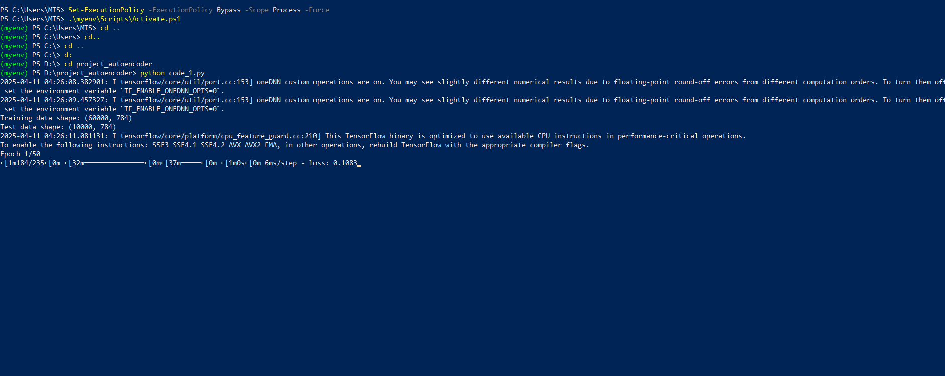
output
10

Slide 11
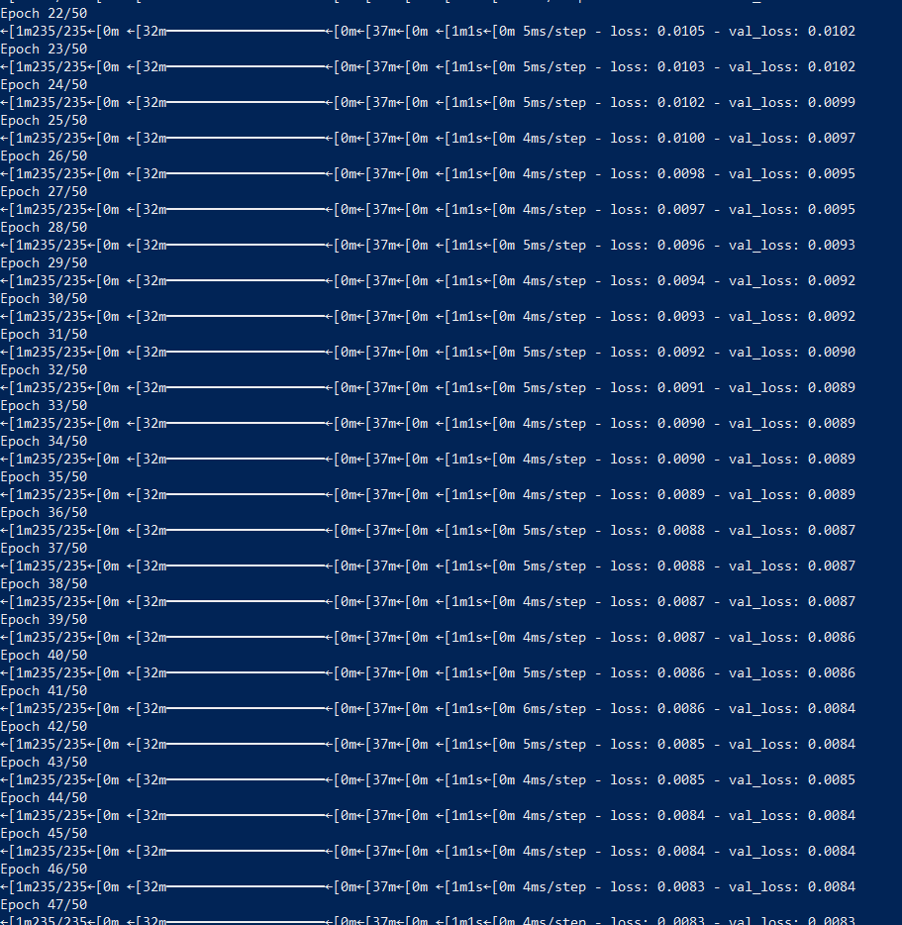
output
11

Slide 12
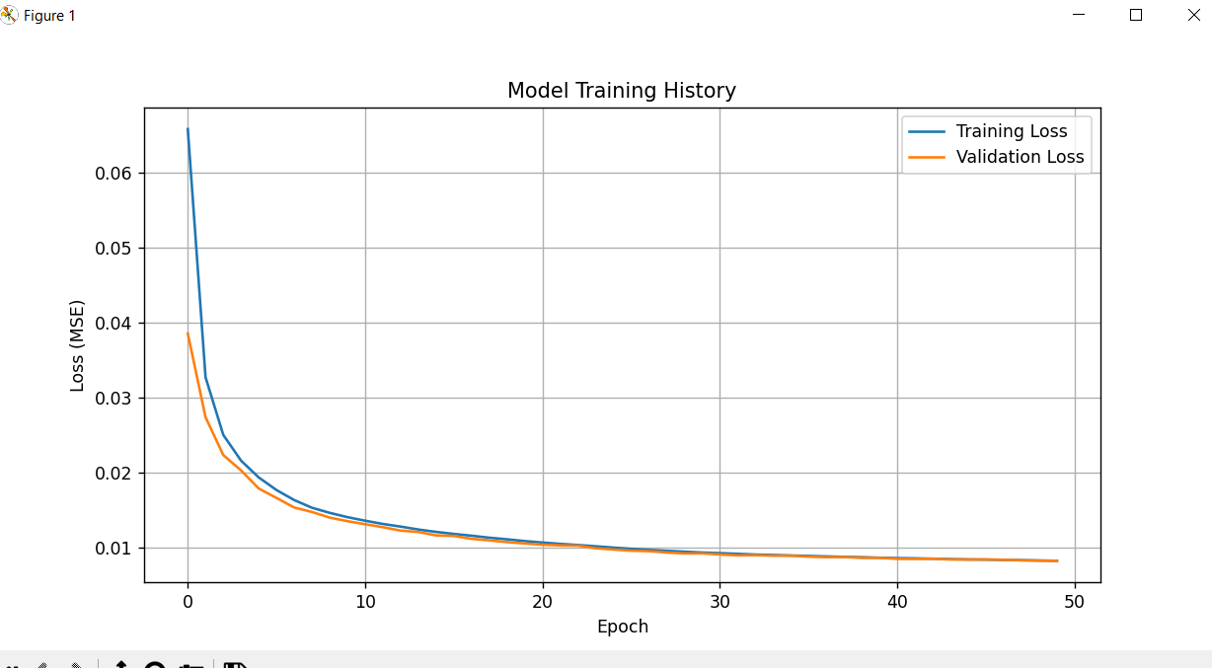
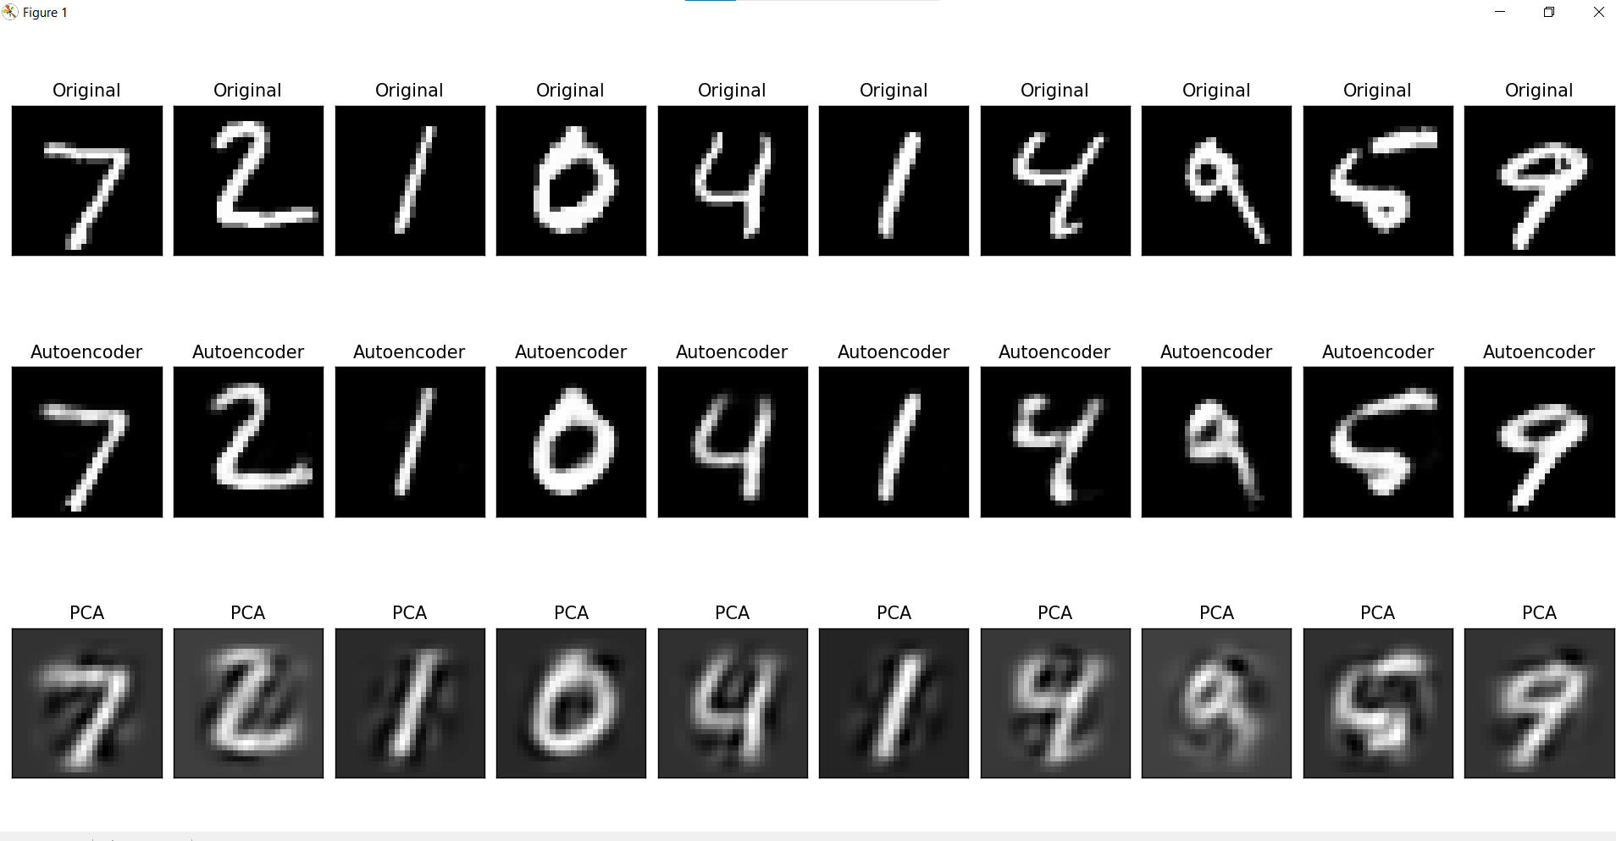
final output
12

Slide 13
Autoencoder vs PCA Results
Original Images
Autoencoder Reconstruction
PCA Reconstruction
13

Slide 14
Challenges & Key Takeaways
Small Datasets
1
Difficult to train.
2
Bottleneck Size
Choosing the right size.
Overfitting
3
Risk of overfitting.
4
Outperforms PCA
On nonlinear data.
Convolutional Layers
5
Can be extended for images.
6
Unsupervised
No need for labeled data.
14

Slide 15

Conclusion
Powerful Tool
Preprocessing
For dimensionality reduction.
Boosts other models performance.
Better Results
For complex data vs PCA.
15

Slide 16

The Power of Autoencoders
At the heart of dimensionality reduction lies an innovative technique - autoencoders. These neural networks possess a remarkable ability to uncover the underlying structure of complex data, allowing us to extract the most salient features while dramatically reducing the dimensionality.
Autoencoders work by learning to encode the input data into a compact, low-dimensional representation, and then decode that representation back into the original input. Through this process, the network is able to identify the essential characteristics that define the data, discarding the superfluous details.
Unlike traditional methods like Principal Component Analysis (PCA), autoencoders are not limited by linear assumptions. They can capture intricate non-linear relationships, unlocking new possibilities for dimensionality reduction and feature extraction. This makes them a powerful tool for a wide range of applications, from image processing to natural language understanding.
By leveraging the power of autoencoders, we can gain deeper insights, streamline our workflows, and uncover hidden patterns that may have eluded us using conventional techniques. The key is to harness this innovative approach and unlock the true potential of your data.
Further research autoencoders and their applications in real-world scenarios. Experiment with different architectures and datasets to gain a deeper understanding.
16

